Slide 1
Stack and Queue

Slide 2
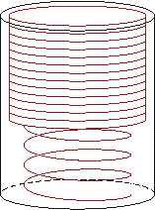
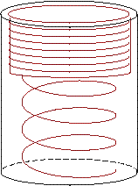
Introduction to Stacks
A stack is a last-in-first-out (LIFO) data structure
Adding an item
  Referred to as pushing it onto the stack
Removing an item
  Referred to as
  popping it from
  the stack

Slide 3
A Stack
Definition:
  An ordered collection of data items
  Can be accessed at only one end (the top)
Operations:
  construct a stack (usually empty)
  check if it is empty
  Push: add an element to the top
  Top: retrieve the top element
  Pop: remove the top element

Slide 4
STACKS
Algorithm:-1
PUSH(STACK,TOP,MAXSTK,ITEM)
1.[Stack already filled]
If TOP=MAXSTK, then: print OVERFLOW, and Return.
2.Set TOP:=TOP+1 // [increases TOP by 1]
3.Set STACK[TOP]:=ITEM //[insert ITEM in new TOP position]
4.Return

Slide 5
Algorithm:-2
POP(STACK,TOP,ITEM)
1.[Stack has an item to be removed]
If TOP=0, then: print UNDERFLOW, and Return.
2.Set ITEM:=STACK[TOP] //[Assigns TOP element to ITEM]
3.Set TOP:=TOP-1 //[Decreases TOP by 1]
4.Return

Slide 6
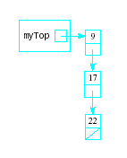
Linked Stacks
Another alternative to allowing stacks to grow as needed
Linked list stack needs only one data member
  Pointer myTop
  Nodes allocated (but not
  part of stack class)

Slide 7
Linked Representation of stack
Algorithm:-3
PUSH_LINKSTACK(INFO,LINK,TOP,AVAIL,ITEM)
This procedure pushes an ITEM into a linked stack
1. //[Available Space?]
if AVAIL=NULL , then write OVERFLOW and EXIT
2. //[Remove first node from the avail list]
set NEW:=AVAIL and AVAIL:=LINK[AVAIL]
3. Set INFO[NEW]:=ITEM //[copies ITEM into new node]
4.Set LINK[NEW]:=TOP //[new node points to the original top node in stack]
5.Set TOP=NEW //[reset TOP to point to new node at the top of stack]
6.Exit

Slide 8
Algorithm:-4
POP_LINKSTACK(INFO,LINK,TOP,AVAIL,ITEM)
This procedure deletes the top element an ITEM into a linked stack and assign it to the variable ITEM
1. //[stack has an item to be removed?]
If TOP=NULL , then write UNDERFLOW and EXIT
2.set ITEM:=INFO[TOP] // [copies the top element of stack into ITEM]
3. Set TEMP:=TOP and TOP=LINK[TOP]
// [remember the old value of the TOP pointer in TEMP and reset TOP to point to the next element in the stack]
4. //[Return deleted node to the AVAIL list]
Set LINK[TEMP]=AVAIL
5.Exit

Slide 9
QUEUE

Slide 10
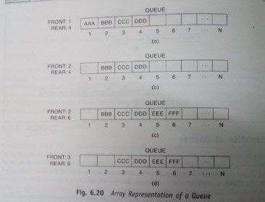
Example1 based on queues

Slide 11
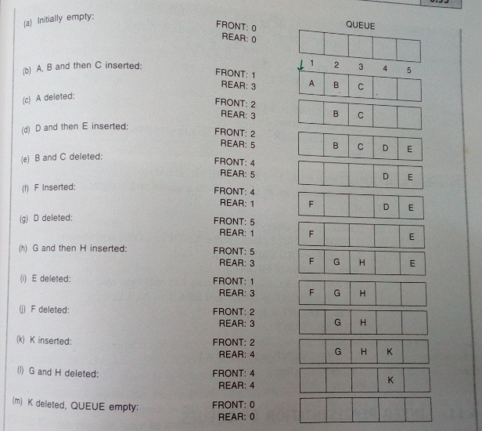
Example2 based on queues

Slide 12
QINSERT(QUEUE,N,FRONT,REAR,ITEM)
This procedure inserts an element ITEM into a queue
1) //[queue already filled?]
If FRONT=1 and REAR=N , or if FRONT=REAR+1
Then: write OVERFLOW and return.
2) // [find new value of REAR]
If FRONT:=NULL // [then queue initially empty]
Set FRONT:=1 and REAR:=1
Else if REAR=N , then :
Set REAR:=1
Else:
Set REAR:=REAR+1
// [end of if structure]
3) Set QUEUE[REAR]:=ITEM //[this inserts new element]
4) RETURN

Slide 13
QDELETE(QUEUE,N,FRONT,REAR,ITEM)
This procedure deletes an element from a queue and assign it to the variable item
1) //[queue already empty?]
If FRONT:=NULL Then: write UNDERFLOW and return
2)Set ITEM:=QUEUE[FRONT]
3) //[find new value of FRONT]
if FRONT=REAR , then: //[queue has only one element]
Set FRONT:=NULL and REAR:=NULL
else if FRONT=N, then: set FRONT:=1
else set FRONT:=FRONT+1
//[end of if structure]
4) RETURN

Slide 14
LINKED REPRESENTATION[INSERT]
If AVAIL=NULL then write OVERFLOW and EXIT
Set NEW=AVAIL and AVAIL=LINK[AVAIL]
Set INFO[NEW]=ITEM and LINK[NEW]=NULL
If FRONT=NULL then FRONT=REAR=NEW
else set LINK[REAR]=NEW and REAR=NEW
5. Exit

Slide 15
LINKED REPRESENTATION[DELETE]
If FRONT=NULL then write UNDERFLOW and EXIT
Set TEMP=FRONT
ITEM=INFO(TEMP)
FRONT=LINK(TEMP)
LINK(TEMP)=AVAIL and AVAIL=TEMP
Exit

Slide 16
Deque (Double-ended queue)
It is a linear list, where element can be added or deleted from either side, but not in the middle.
Left = 4
Right = 7
 |  |  | AAA | BBB | CCC | DDD
1 | 2 | 3 | 4 | 5 | 6 | 7 | 8
Left = 7
Right = 2
YYY | ZZZ |  |  |  |  | WWW | XXX
1 | 2 | 3 | 4 | 5 | 6 | 7 | 8

Slide 17
There are two variations of deque:-
Input restricted deque and output restricted deque
Input restricted deque is that which allows insertions at only one end of the list but deletions at both end of the list: and an output restricted deque is a deque which allows deletions at only one end and insertions

Slide 18
Priority Queue
It is a collection of element such that each element has been assigned a priority, hence
  An element of higher priority is processed before any element of lower priority.
  Two elements with same priority are processed according to order in which they were added to queue.

Slide 19
It can be maintained in memory by means of one-way list as:
  Each node will contain 3 items → info, priority_no & link
  A node X precedes a node Y in list when,
    X has higher priority than Y
    Both have same priority but X was added to list before Y

Slide 20
Polish (Prefix) Notation

Slide 21
Arithmetic Expressions
Arithmetic Expressions involve constants and operations.
Binary operations have different levels of precedence.
  First : Exponentiation (^)
  Second: Multiplication (*) and Division (/)
  Third : Addition (+) and Subtraction (-)

Slide 22
Example
Evaluate the following Arithmetic Expression:
5 ^ 2 + 3 * 5 – 6 * 2 / 3 + 24 / 3 + 3
First:
  25 + 3 * 5 – 6 * 2 / 3 + 24 / 3 + 3
  Second:
  25 + 15 – 4 + 8 + 3
  Third:
  47

Slide 23
Infix Notation
Infix Notation: Operator symbol is placed between the two operands.
Example:
(5 * 3) + 2 & 5 * (3 + 2)

Slide 24
Polish Notation
Polish Notation: The Operator Symbol is placed before its two operands.
Example: + A B, * C D, / P Q etc.
In prefix notation you put the operator first followed by the things it acts on and enclose the whole lot in brackets.
So for example if you want to write 3+4, in scheme you say: (+ 3 4)

Slide 25
Examples
(A + B) * C =
* + ABC
A + (B * C) =
+ A *BC
(A + B) / (C - D) =
/ +AB –CD
Also Known as Prefix Notation.

Slide 26
Advantage of Prefix notation
The advantage of the prefix notation is that no operator precedence is required; the bracketing shows what the operator acts on.
So in scheme if you want 3×4+2, you say : (+ (* 3 4) 2)
And if you want 3x(4+2), you write: (* 3 (+ 4 2))
So in scheme, you don’t need operator precedence, but you do need lots of brackets.

Slide 27
Reverse-Polish (Postfix) Notation

Slide 28
Reverse Polish Notation
Reverse Polish Notation: The Operator Symbol is placed after its two operands.
Example: A B+, C D*, P Q/ etc.
Also known as Postfix Notation.

Slide 29
Postfix and Prefix Examples
INFIX POSTFIX PREFIX
A + B
A * B + C
A * (B + C)
A - (B - (C - D))
A - B - C - D
A B +
+ A B
A B * C +
+ * A B C
A B C + *
* A + B C
A B C D---
-A-B-C D
A B-C-D-
---A B C D
Prefix : Operators come before the operands

Slide 30
Advantage of Postfix notation
You can easily evaluate a postfix expression in a single scan from left to right with the help of a stack (unlike evaluating infix expressions).
There is no need of the concept of parentheses and precedence rules etc. in a postfix expression.

Slide 31
Transforming Infix into Postfix
By hand: "Fully parenthesize-move-erase" method:
1. Fully parenthesize the expression.
2. Replace each right parenthesis by the corresponding operator.
3. Erase all left parentheses.
Examples:
A * B + C →
((A * B) + C)
A * (B + C) →
(A * (B + C) )
→ ((A B * C +
→ A B * C +
→ (A (B C + *
→ A B C + *

Slide 32
Infix to Postfix
A + ( B * C – ( D / E ↑ F ) * G ) * H
Symbol Scanned | Stack | Expression P
A | ( | A
+ | ( + | A
( | ( + ( | A
B | ( + ( | A B
* | ( + ( * | A B
C | ( + ( * | A B C
- | ( + ( - | A B C *
( | ( + ( - ( | A B C *
D | ( + ( - ( | A B C * D
/ | ( + ( - ( / | A B C * D
E | ( + ( - ( / | A B C * D E
↑ | ( + ( - ( / ↑ | A B C * D E

Slide 33
A + ( B * C – ( D / E ↑ F ) * G ) * H
Symbol Scanned | Stack | Expression P
F | ( + ( - ( / ↑ | A B C * D E F
) | ( + ( - | A B C * D E F ↑/
* | ( + ( - * | A B C * D E F ↑/
G | ( + ( - * | A B C * D E F ↑/ G
) | ( + | A B C * D E F ↑/ G * -
* | ( + * | A B C * D E F ↑/ G * -
H | ( + * | A B C * D E F ↑/ G * - H
) |  | A B C * D E F ↑/ G * - H * +

Slide 34
Infix to Postfix Transformation (Algo.)
POLISH (Q, P)
PUSH “(” on to STACK and add “)” to the end of Q.
Scan Q from left to right and Repeat steps 3 to 6 for each element of Q until the STACK is empty:
If an operand is encountered, add it to P.
If a left parenthesis is encountered, push it onto STACK.
If an operator is encountered, then:
(a) Repeatedly POP from STACK and add to P each operator (On the TOP of STACK) which has the same precedence as or higher precedence than @.
(b) Add @ to STACK.
[End of If structure.]
If a right parenthesis is encountered, then:
(a) Repeatedly POP from STACK and add to P each operator (On the TOP of STACK.) until a left parenthesis is encountered.
(b) Remove the left parenthesis. [Don’t add the left parenthesis to P.]
[End of If Structure.]
[End of step 2 Loop.]
7. Exit.

Slide 35
Evaluating Postfix (RPN) Expressions
"By hand" (Underlining technique):
1. Scan the expression from left to right to find an operator.
2. Locate ("underline") the last two preceding operands
and combine them using this operator.
3. Repeat until the end of the expression is reached.
Example:
2 3 4 + 5 6 - - *
→ 2 3 4 + 5 6 - - *
→ 2 7 5 6 - - *
→ 2 7 5 6 - - *
→ 2 7 -1 - *
→ 2 7 -1 - * →
2 8 * →
16
2 8 * →

Slide 36
Evaluation of Postfix (RPN) Expression (Algo.)
P is an arithmetic expression in Postfix Notation.
Add a right parenthesis “)” at the end of P.
Scan P from left to right and Repeat Step 3 and 4 for each element of P until the sentinel “)” is encountered.
If an operand is encountered, put it on STACK.
If an operator @ is encountered, then:
(A) Remove the two top elements of STACK, where A is the top element and B is the next to top element.
(B) Evaluate B @ A.
(C) Place the result of (B) back on STACK.
[End of if structure.]
[End of step 2 Loop.]
Set VALUE equal to the top element on STACK.
Exit.

Slide 37
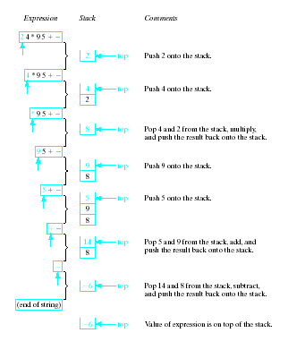
Evaluating
RPN
Expressions

Slide 38
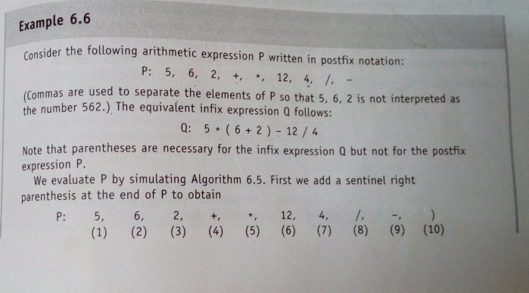
Example of evaluation of postfix expression

Slide 39
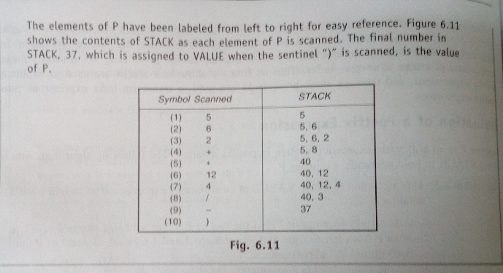

Slide 40
Tower of Hanoi

Slide 41
Algorithm
Tower (N, Beg, Aux, End)
If N = 1, then
    Write Beg→End
    Return
// [Move N-1 disks from Beg to Aux]
Call Tower (N-1, Beg, End, Aux)
Write Beg→End
4. // [Move N-1 disks from Aux to End]
Call Tower (N-1, Aux, Beg, End)
7. Return

